Slide 1


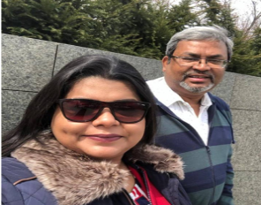
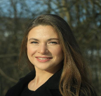

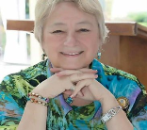

You are Invited!
Soroptimist Road Trip
October 1, 2019 – September 30, 2021

Slide 2

What to Bring for the Road Trip!
Hearts
Minds
Voices
Passions
Money

Slide 3

LEAVE NO ONE BEHIND

Slide 4


Slide 5



PRESIDENTS APPEAL 2019-2021

Slide 6

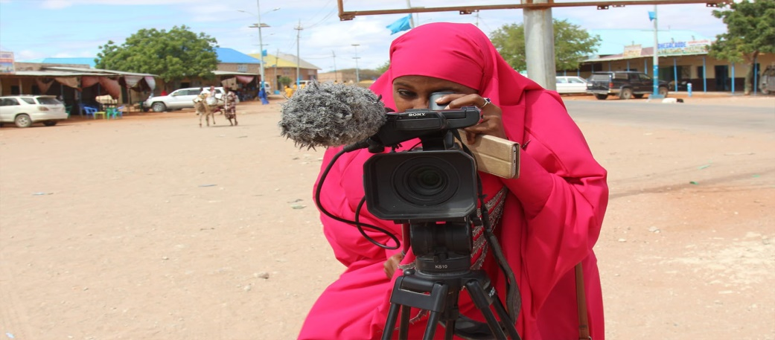
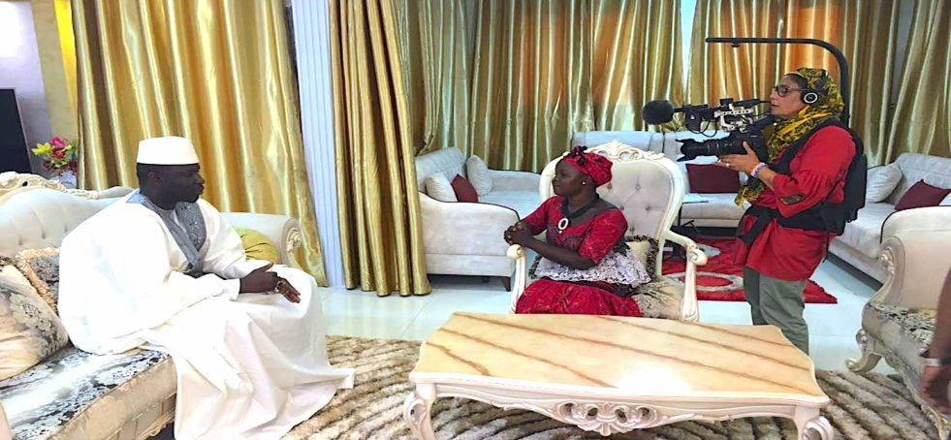
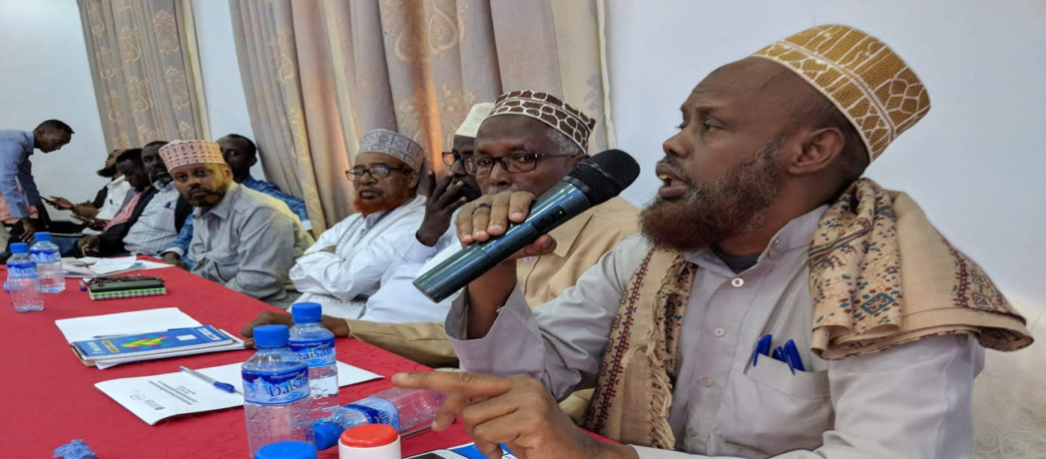
FGM/C

Slide 7




Child marriage is no happily-ever-after

Slide 8

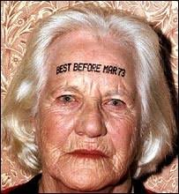



The Rights of Older Women
Frances, UN Rep NY
Expert Speaker

Slide 9

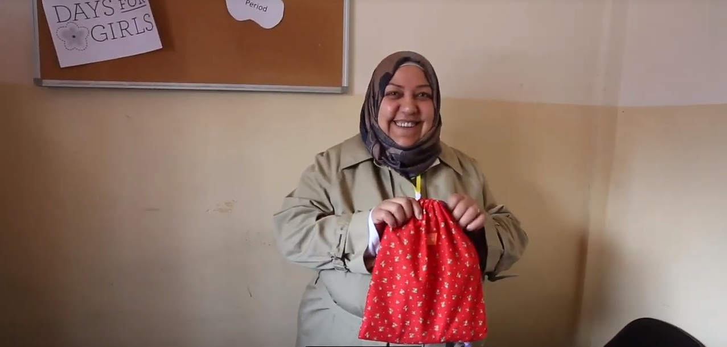
Migration
Sanitation in Refugee Camps

Slide 10

Domestic Violence

Slide 11



Modern Day Slavery

Slide 12
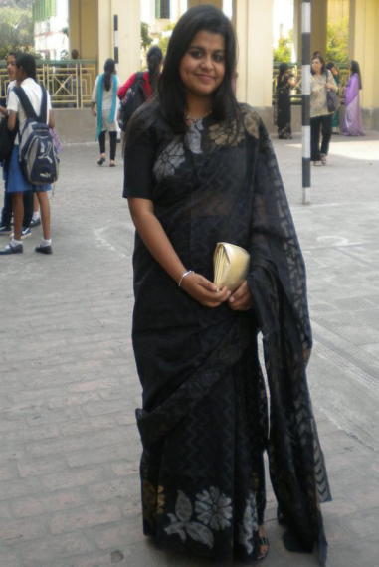
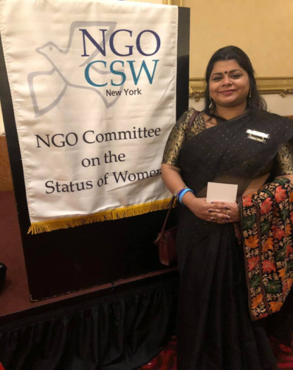

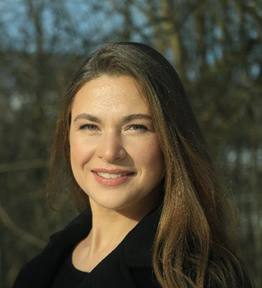
The Team Leaders
Ayushi Kundu, SIGBI
Human Rights Lawyer
Olga Sidenko, SIE
Masters in Accountancy & Audit
International Trade Experience
Migration, Refugee Consultant

Slide 13


See you on the bus!
October 1, 2019 – September 30, 2021

Slide 14




Thank you for all you do!!!
Thank you for your support!!!
NOW…..
LET’S PARTY LIKE WE ARE 100!!!!

